Slide 1
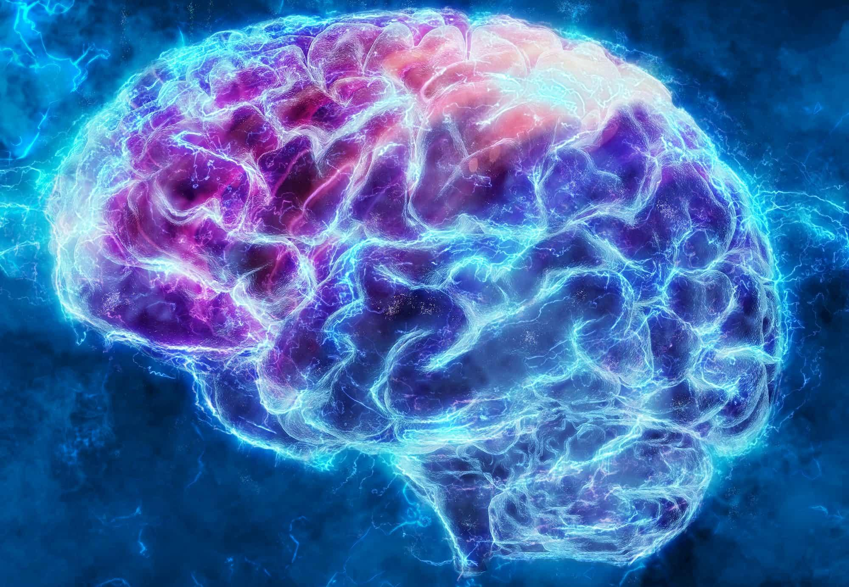

Deep Learning - Final Project
How the Human Brain Makes Sense of Natural Scenes
Eleni Neti R.N : 2022202204018
Petros-Fotis Kamberi R.N. : 2022202204012

Slide 2
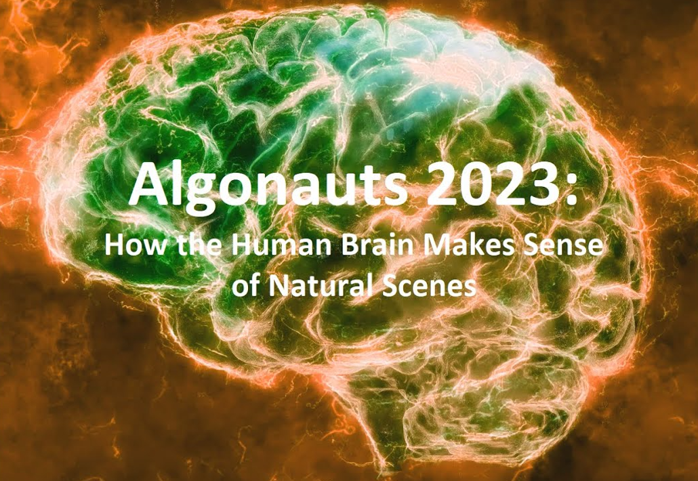
Project description
Based on the Algonauts 2023 challenge.
Objective:
Understanding how the human brain works
by predicting human brain responses to
complex natural visual scenes.
Goal:
Develop computational models to accurately
predict brain responses

Slide 3
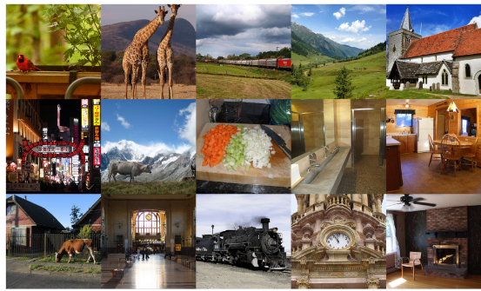

The dataset
Natural Scenes Dataset (NSD)
A massive dataset of high- quality fMRI responses
to ~73,000 different natural scenes.
The experiment
Eight (8) individuals (subjects) where exposed to
~73.000 different naturalistic colored scenes during
fMRI scanning sessions.
We focus only on the data regarding the
subject #1.

Slide 4
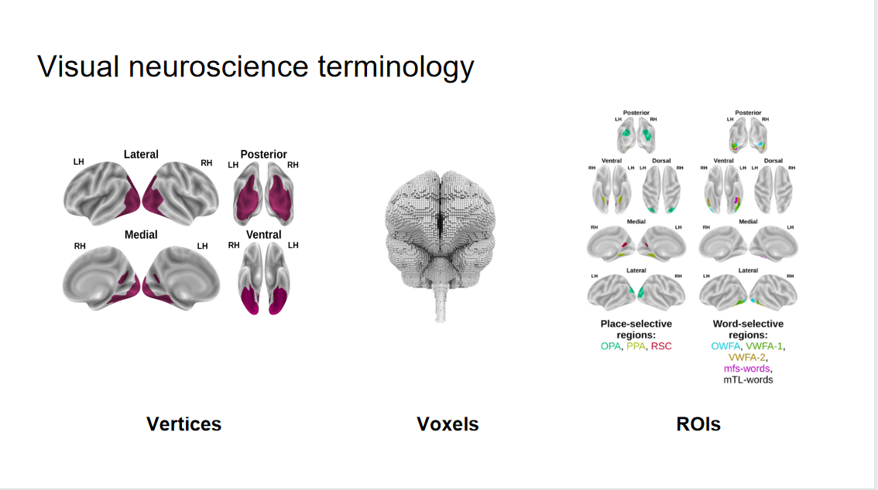

Slide 5
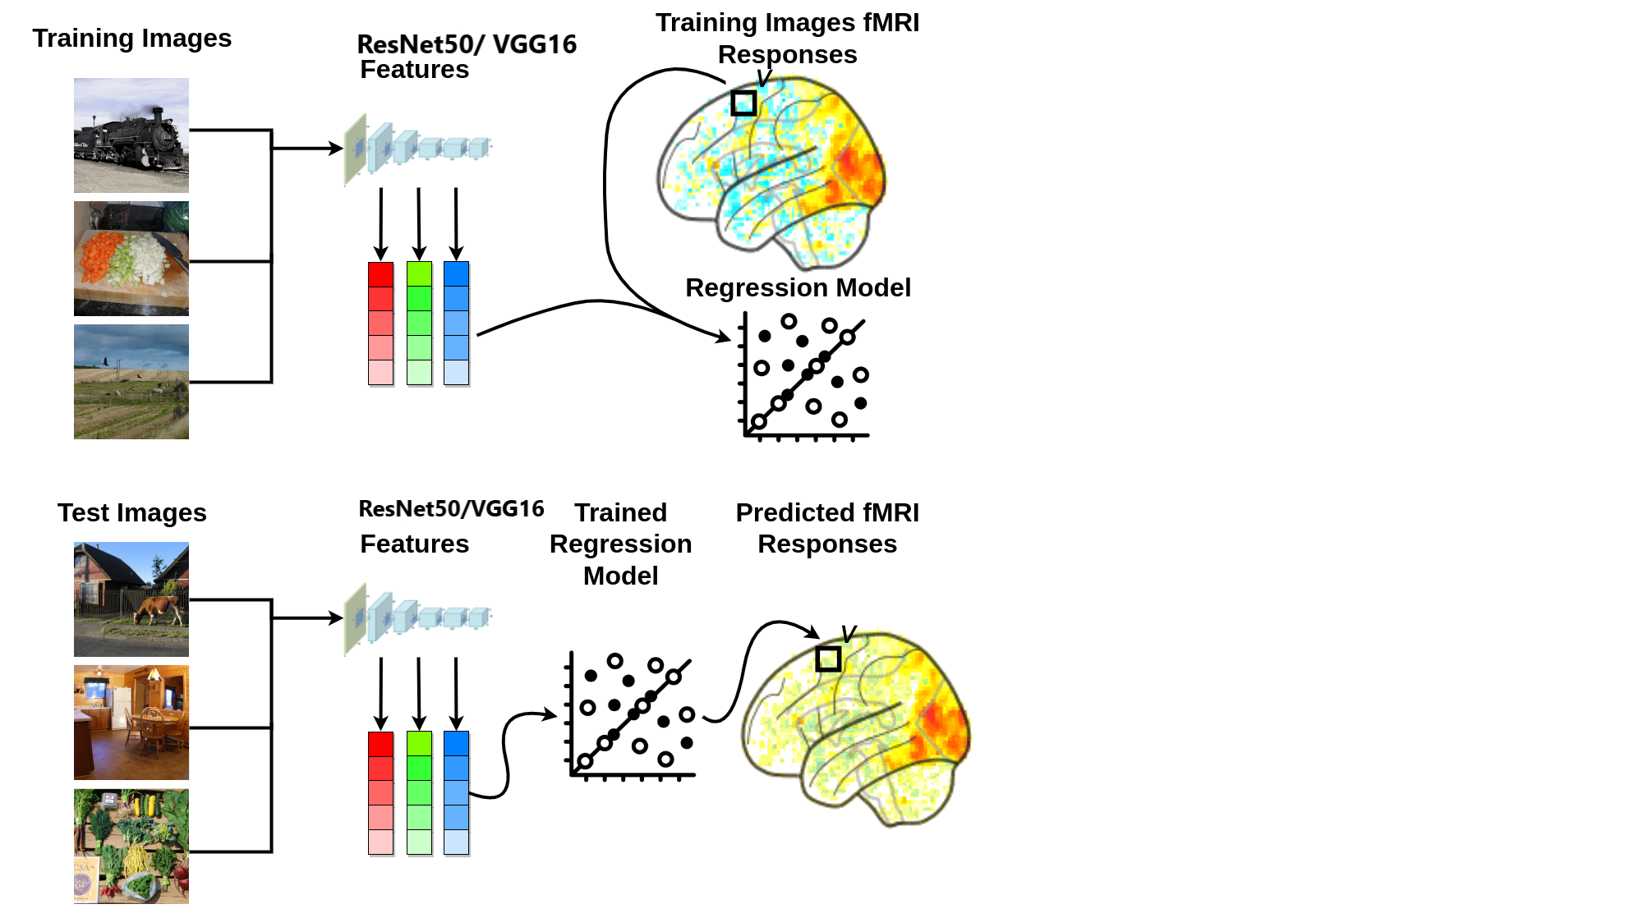
Outline of a Linearizing Encoding Model
Extract features from images using a computer vision pretrained model, transforming the data format and reducing dimensionality.
Linearly map (via regression) the computational model's features to brain responses (voxel values), accounting for multiple features' contributions to each brain area.
Apply the estimated mapping from the training data to predict (i.e. encode) brain responses for the test images.
Compare the predicted brain responses to the withheld ground-truth data.

Slide 6
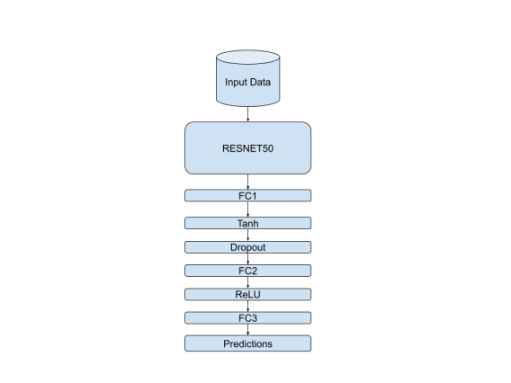
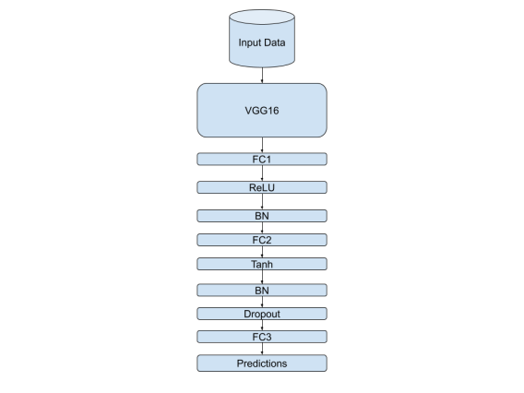
Transfer Learning
Two models for each brain hemisphere: ResNet50 and VGG16.
Last layer of each pretrained model was removed and three fully connected layers were added.
Input: pretrained model features of the input images.
Output: brain voxel values.
Optional layers included for enhanced expressiveness and flexibility.
Model architecture allows for customization based on experimental requirements and optimization results.
Optuna autoML tool used to determine transfer learning model architecture configuration.

Slide 7
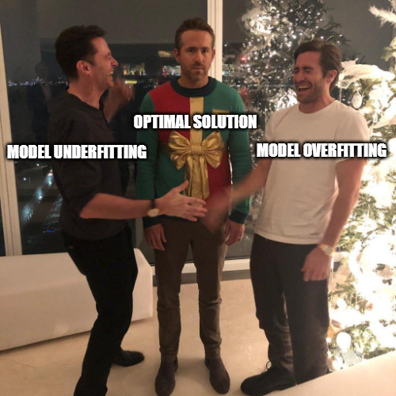
Mitigating Overfitting
Batch Normalization to normalize layer inputs and reduce overfitting.
Dropout was applied to randomly drop units during training and improve generalization.
Early stopping was implemented based on validation loss. Training halts if no improvement in validation loss for three consecutive epochs.
Validation loss comparison considers two significant decimal digits to ensure meaningful improvement before resetting early stopping counter.
Optuna optimized learning rate, and weight decay hyperparameters and chose the optimizer to further prevent overfitting.

Slide 8
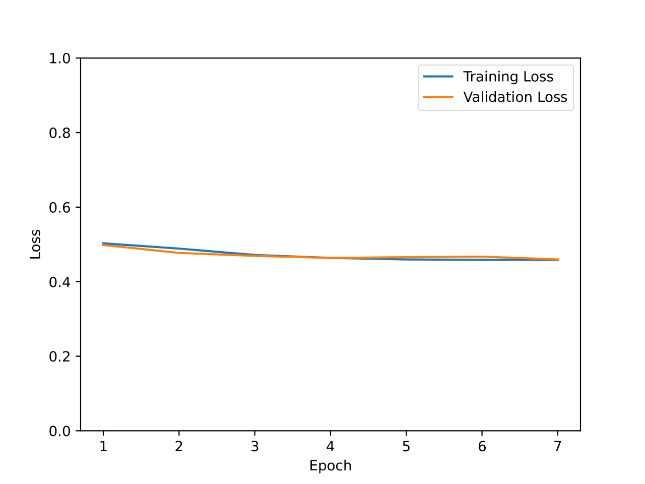
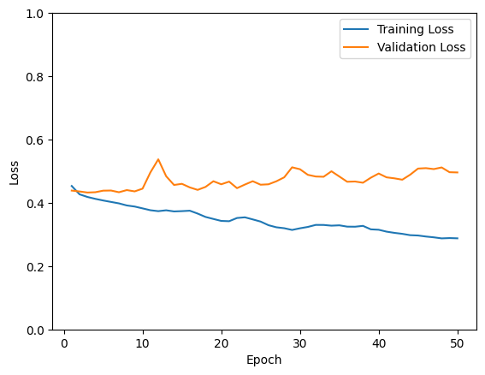
Before and After using Mechanisms for Mitigating Overfitting

Slide 9
Evaluation - Metrics
Evaluation metrics: Calculated R2 (where higher is better) score, as well as RMSE, MAE, and Smooth L1 scores (where lower is better) to quantitatively assess the model's performance
RESNET50 based Model
LH RMSE | 0.6769
LH R2 | 0.0799
LH MAE | 0.5354
LH Smooth L1 Loss | 0.2162
RH RMSE | 0.6789
RH R2 | 0.0690
RH MAE | 0.5373
RH Smooth L1 Loss | 0.2175
VGG16 based Model
LH RMSE | -0.0014
LH R2 | -0.0014
LH MAE | 0.5619
LH Smooth L1 Loss | 0.2352
RH RMSE | 0.7201
RH R2 | -0.0412
RH MAE | 0.5719
RH Smooth L1 Loss | 0.2424

Slide 10
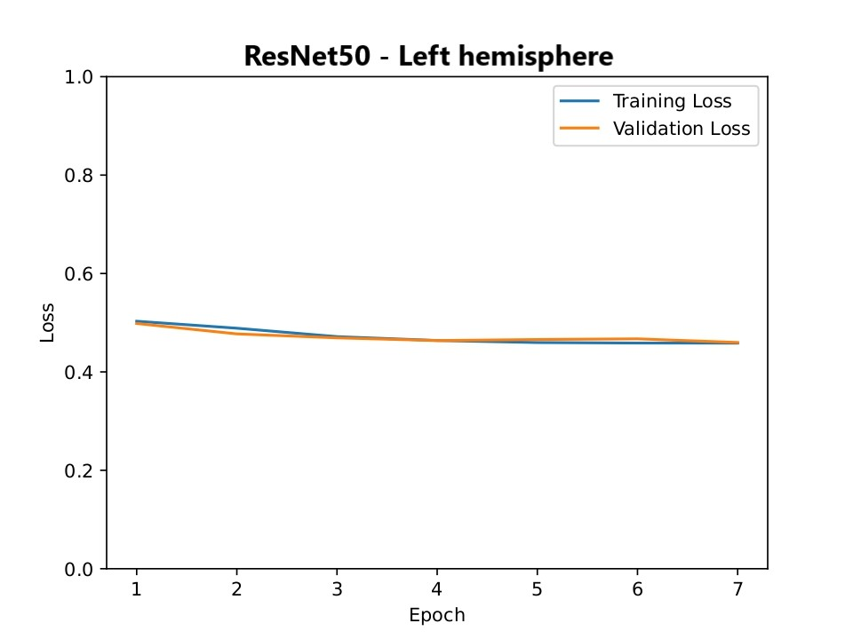
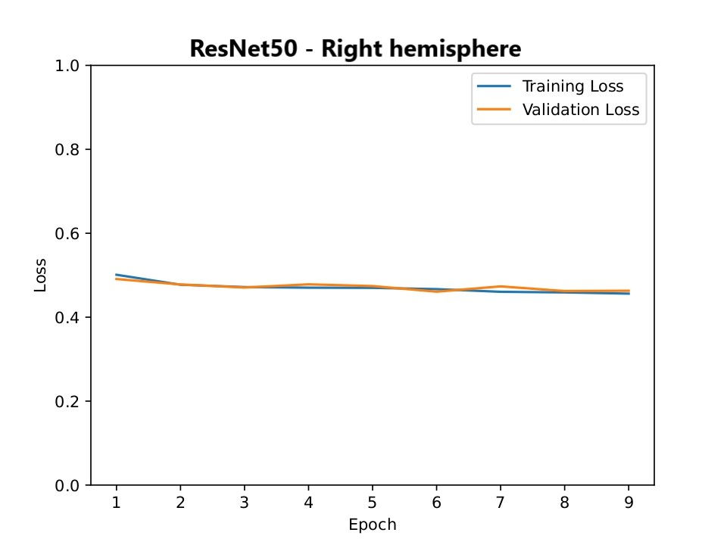
Evaluation - Learning Curves (RESNET50 based model)
Learning curves: Plotted the train and validation loss over epochs to analyze the model's learning dynamics and identify underfitting or overfitting.

Slide 11
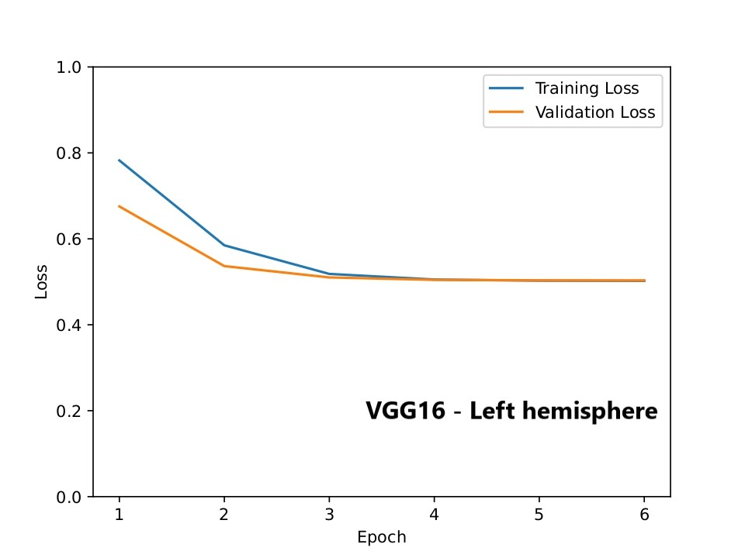
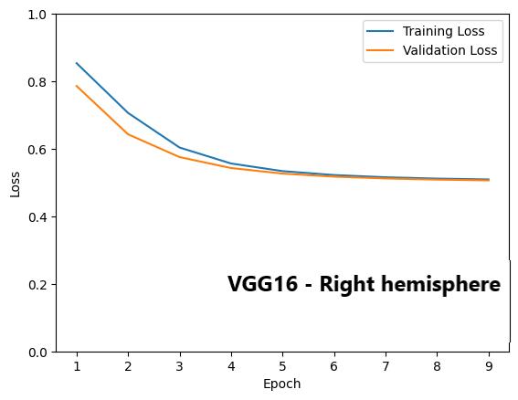
Evaluation - Learning Curves (VGG16 based model)
Learning curves: Plotted the train and validation loss over epochs to analyze the model's learning dynamics and identify underfitting or overfitting.

Slide 12
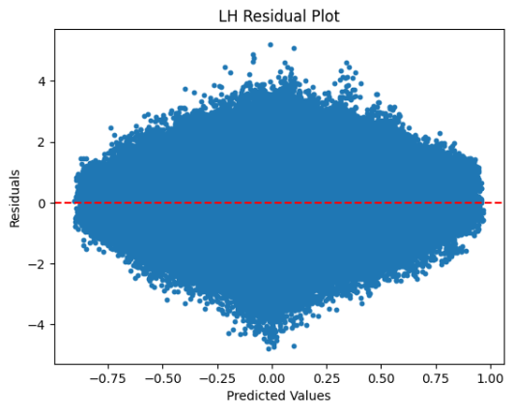
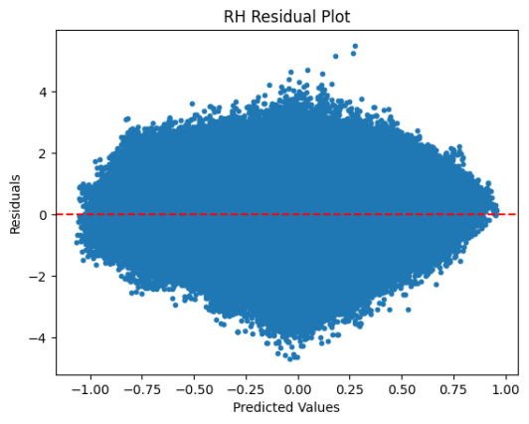
Evaluation - Residual Plots (RESNET50 based model)
Residual plots: Examined the differences between predicted and actual voxel values to assess the quality of the model's predictions and identify systematic patterns or biases.

Slide 13
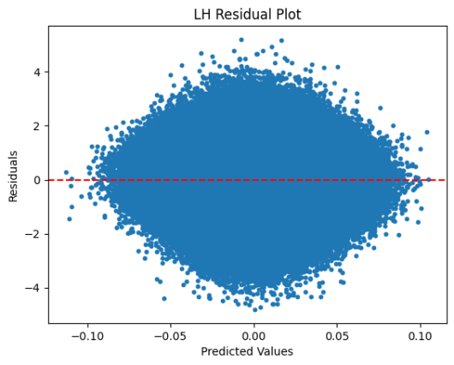
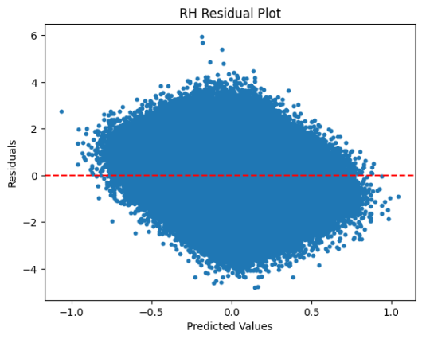
Evaluation - Residual Plots (VGG16 based model)
Residual plots: Examined the differences between predicted and actual voxel values to assess the quality of the model's predictions and identify systematic patterns or biases.

Slide 14
Evaluation - Brain Surface Heatmaps
Pearson correlation: Computed the correlation coefficient to measure the linear relationship between predicted and actual voxel values, indicating how well the model captured the underlying relationship.
Heatmap visualization: Generated brain surface maps using Nilearn to visualize the predicted voxel values as a heatmap, providing spatial representation and identifying regions of accurate predictions.

Slide 15
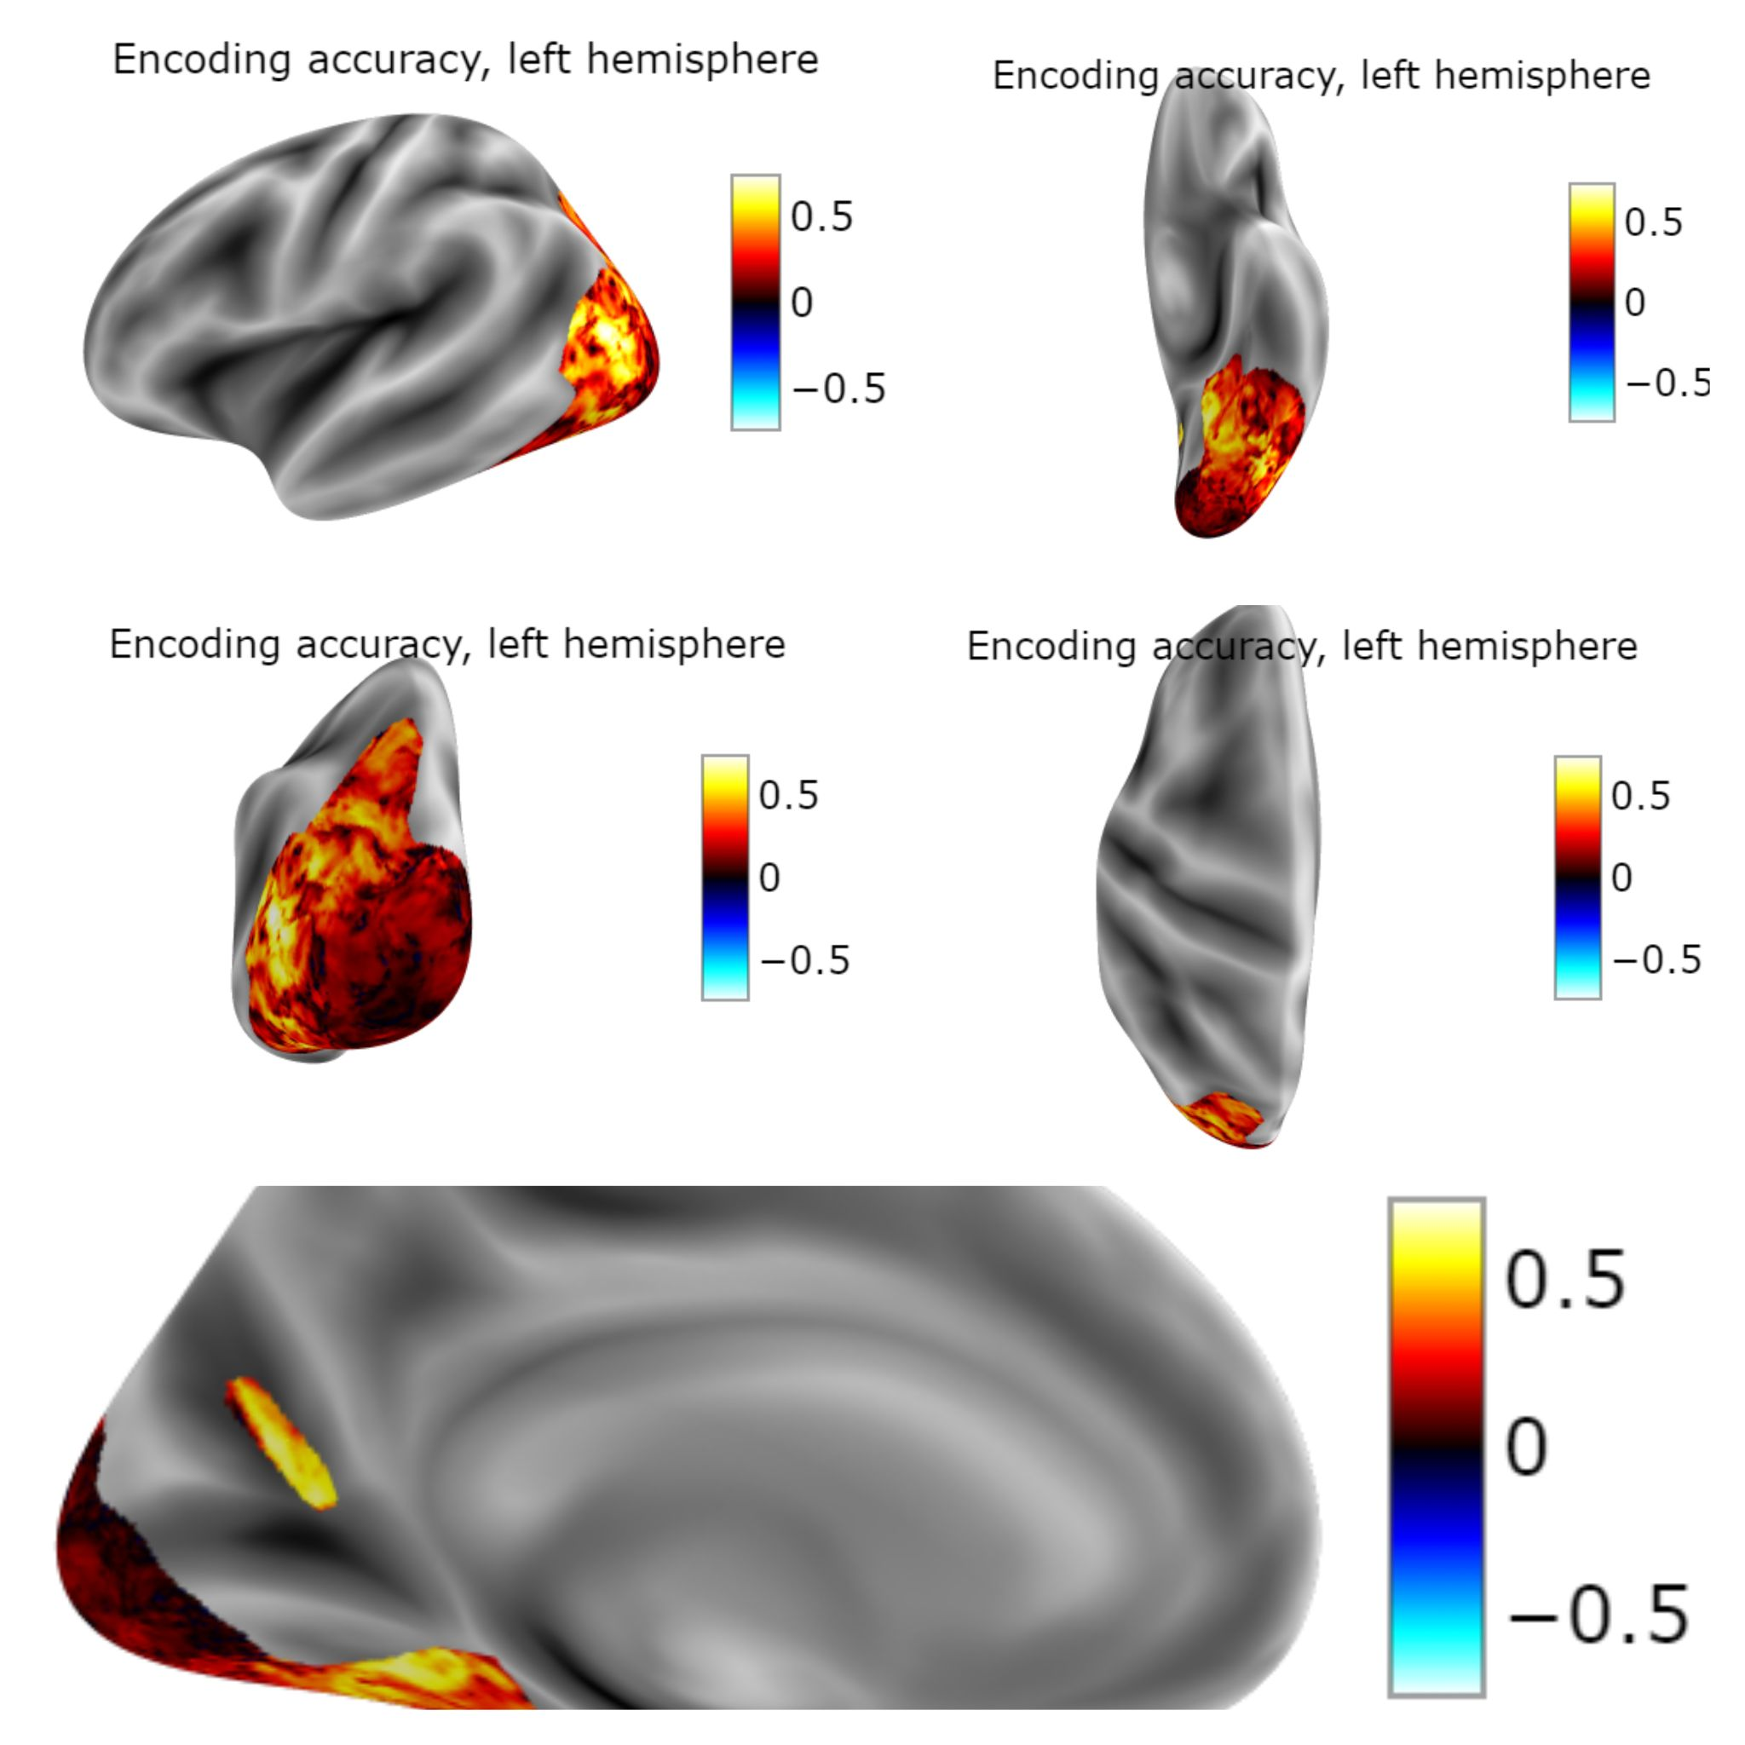
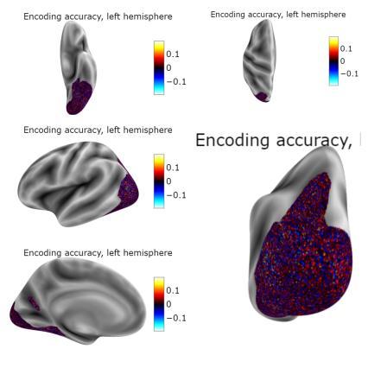
Brain surface heatmaps (left: RESNET50 based model, right: VGG16 based model)

Slide 16
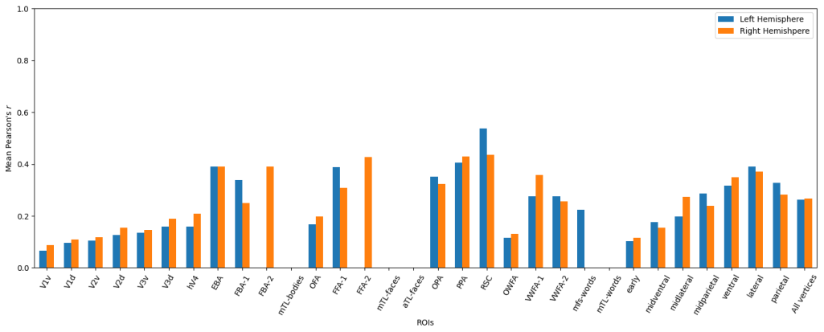
Evaluation - Regional Analysis (RESNET50 based model)
Regional analysis: Plotted Pearson correlation barchart for each brain ROI in the left and right hemisphere to evaluate the model's performance on specific brain regions, gaining insights into regional performance variations.

Slide 17
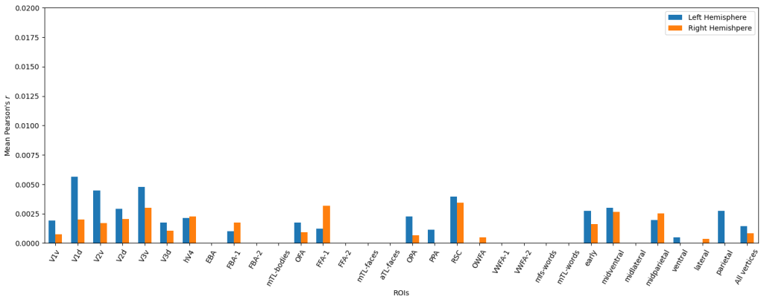
Evaluation - Regional Analysis (VGG16 based model)
Regional analysis: Plotted Pearson correlation barchart for each brain ROI in the left and right hemisphere to evaluate the model's performance on specific brain regions, gaining insights into regional performance variations.

Slide 18
DEMO
Created a simple demo to showcase the model's capabilities.
Applied the model on both test images from the dataset and external images.
Generated visualizations that plot the input image alongside the predicted brain response for all examined vertices of the brain.
Enabled the ability to selectively visualize the image with the brain response on specific regions of interest (ROIs) within the brain.

Slide 19
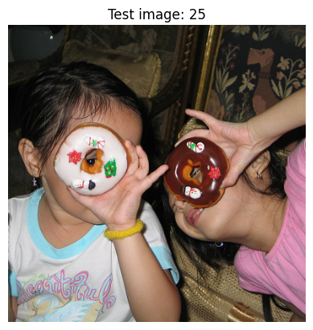
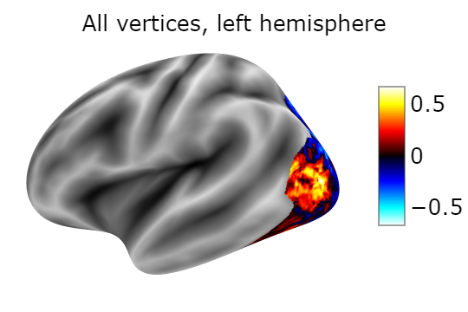
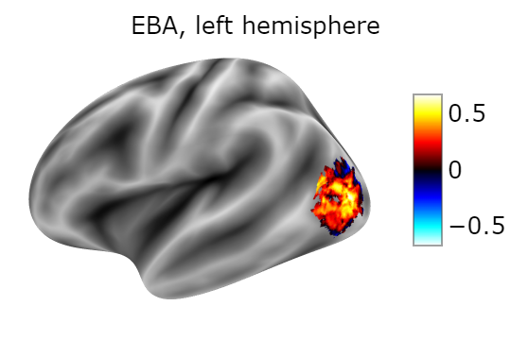
DEMO - Test image example

Slide 20

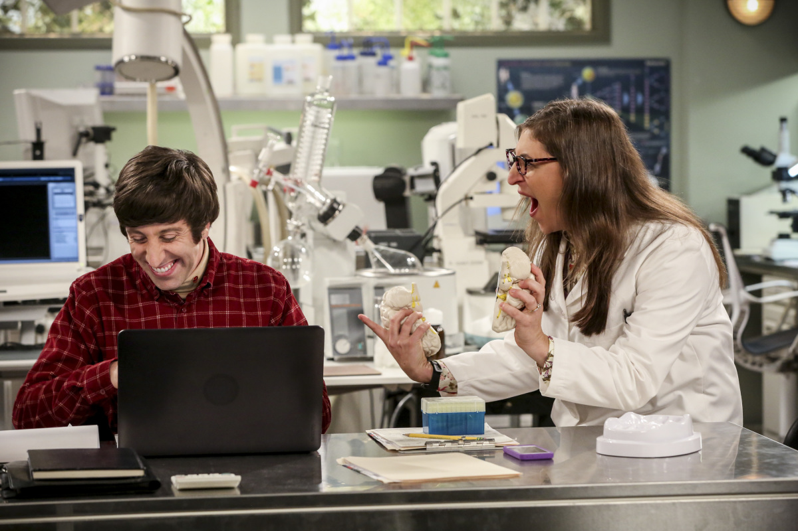
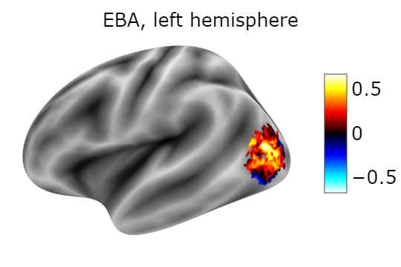
DEMO - External image example

Slide 21
Any Questions ?

Slide 22
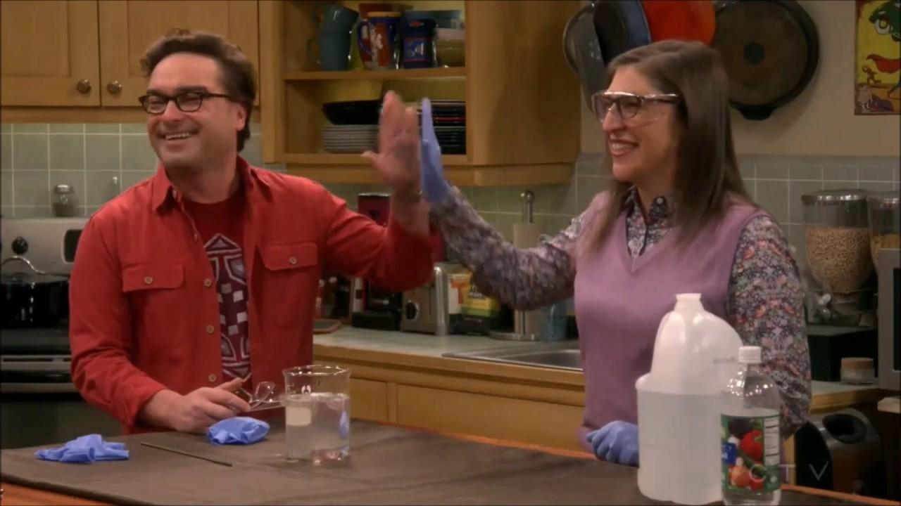
Thank You!

